Slide 1
DS Case Study 1
Group Members:
  Sanuja Chakraborty
  Subhasish Mula
  Souptik Sarkar

Slide 2
Agenda:
Handling Missing Data
Outlier Detection and Treatment
Feature Engineering
Feature Importance
Model Comparison and Optimization

Slide 3
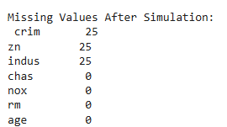
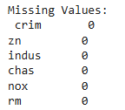
Handling Missing Values:
As in the dataset we have no missing values so we will simulate the data and will introduce missing values in the dataset and then we will show how to handle it.
After simulating the missing values in the dataset we handle the missing values with Mean Imputation.
Mean imputation is a technique used to handle missing values in a dataset by replacing the missing values with the mean (average) of the observed values in that column.

Slide 4
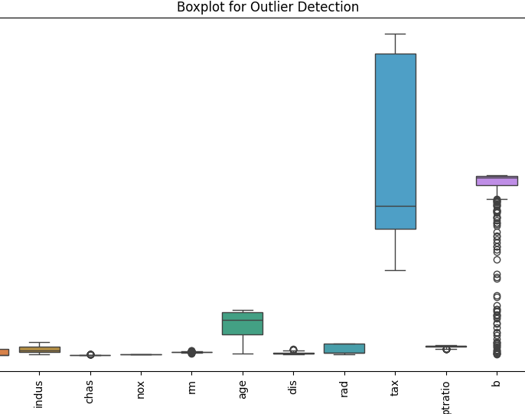
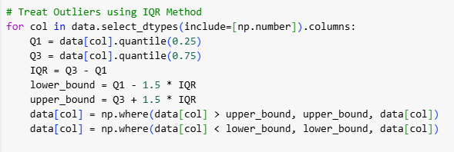
Outlier Detection and Boxplot:
An outlier is a data point that differs significantly from other observations. It can be either unusually high or unusually low.
Box plots are a powerful visual tool for identifying outliers in a dataset. They provide a concise summary of the data's distribution, highlighting key quartiles and potential extreme values.
How Box Plots Detect Outliers:
Quartile Calculation: The box plot divides the data into four quartiles:
  Q1 (First Quartile): The 25th percentile of the data.
  Q2 (Second Quartile or Median): The 50th percentile of the data.
  Q3 (Third Quartile): The 75th percentile of the data.
Interquartile Range (IQR): The IQR is calculated as Q3 - Q1, representing the middle 50% of the data.
Whisker Length: The whiskers of the box plot extend to a maximum of 1.5 times the IQR from the edges of the box (Q1 and Q3).
Outlier Identification: Any data points that fall outside the whiskers are considered potential outliers. These points are often plotted individually beyond the whiskers

Slide 5
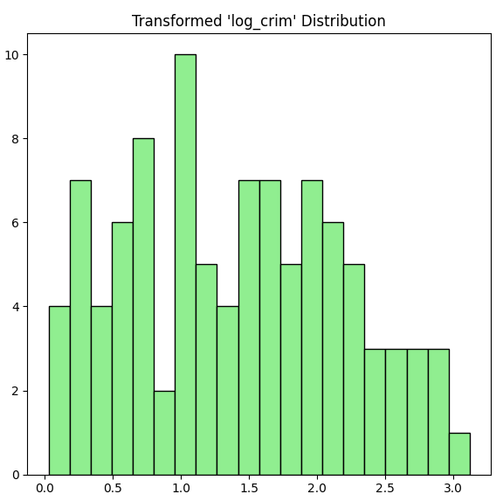
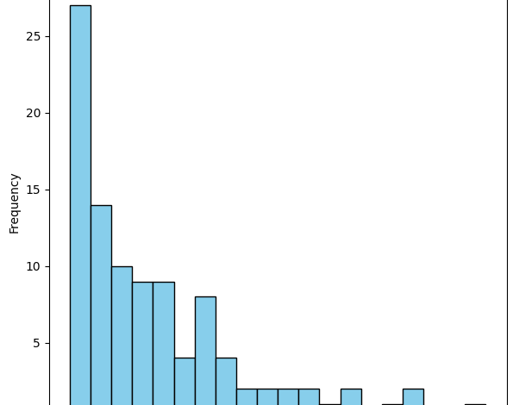
Feature Engineering:
Feature Engineering: The Secret Sauce of Machine Learning
Feature engineering is the process of transforming raw data into features that are suitable for machine learning algorithms. It involves selecting, extracting, and transforming the most relevant information from the data to improve model performance.
A histogram shows the distribution of a single feature (log_crim) after transformation.
Log transformations often help in handling skewed data and make the feature more normally distributed.
The histogram makes it easy to observe how the transformation affects the feature's shape.
Before Transformation:
A skewed feature may show a long tail in the histogram.
After Log Transformation:
The histogram should show a more symmetrical distribution or reduced skewness.

Slide 6
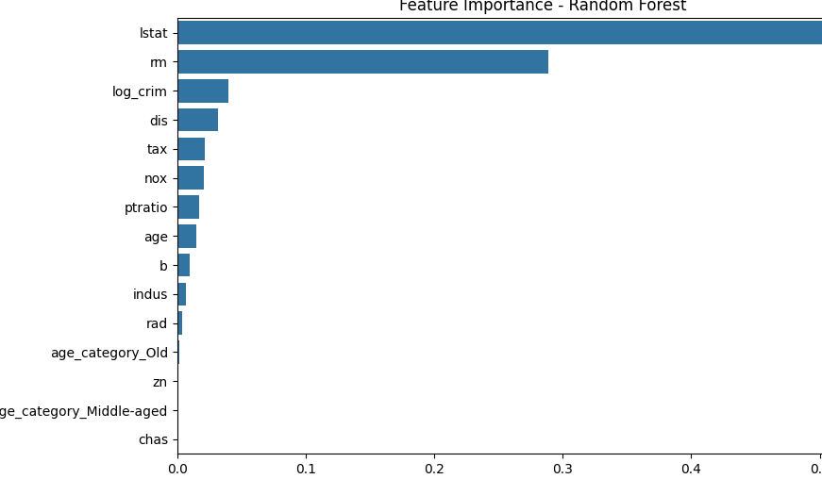
Feature Importance:
Overview:
  Feature importance helps identify which features contribute the most to the model's predictions.
  We used the Random Forest model to compute feature importance scores.
Key Insights:
  The barplot shows the importance of each feature based on the Random Forest model.
  Top Features: Highlight the features with the highest importance scores as they play a major role in predicting the target variable.
  Low-Importance Features: These features contribute less and could potentially be removed for model optimization.
Why Feature Importance Matters:
  Helps in dimensionality reduction by eliminating irrelevant features.
  Improves model interpretability and performance.
  Visual:
Include a barplot of feature importance with:
  Features sorted in descending order of importance.
  Highlight the top 3 most important features using a different color for emphasis.

Slide 7

Model Comparison:
Overview:
To evaluate the performance of different regression models, we compared their Mean Squared Error (MSE) and R² scores on the test dataset.
Models included:
  Linear Regression
  Ridge Regression
  Lasso Regression
  Random Forest
  Key Metrics:
MSE (Mean Squared Error): Measures the average squared difference between predicted and actual values (lower is better).
R² Score: Represents how well the model explains the variance in the target variable (higher is better).
Findings:
The side-by-side bar chart shows that Random Forest performs best with the lowest MSE and highest R² score, indicating its superior predictive accuracy.
Linear Regression, while simple, underperformed due to its inability to capture complex relationships.
Ridge and Lasso show moderate improvements over Linear Regression due to regularization.

Slide 8

Hyperparameter Tuning:
Overview:
Hyperparameter tuning is the process of finding the best model parameters that optimize performance.
For Ridge Regression, the key hyperparameter is alpha (controls the regularization strength).
Approach:
We used Grid Search Cross-Validation to systematically test multiple values of alpha.
Grid Search evaluates each combination of hyperparameters and selects the one that yields the best performance based on a scoring metric (e.g., MSE).
Results:
The Grid Search results identified the best parameter:
  Alpha = 1.0
This value strikes a balance between minimizing overfitting and improving generalization.
Insights:
Proper tuning of hyperparameters significantly improves model performance.
Regularization (via alpha) helps reduce model complexity, especially when dealing with multicollinearity or overfitting.

Slide 9

Thank You!!!

